Slide 1

IBM Capstone Project — The Battle of Neighborhoods- Opening Café in Kuala Lumpur
Azrul Ihsan

Slide 2
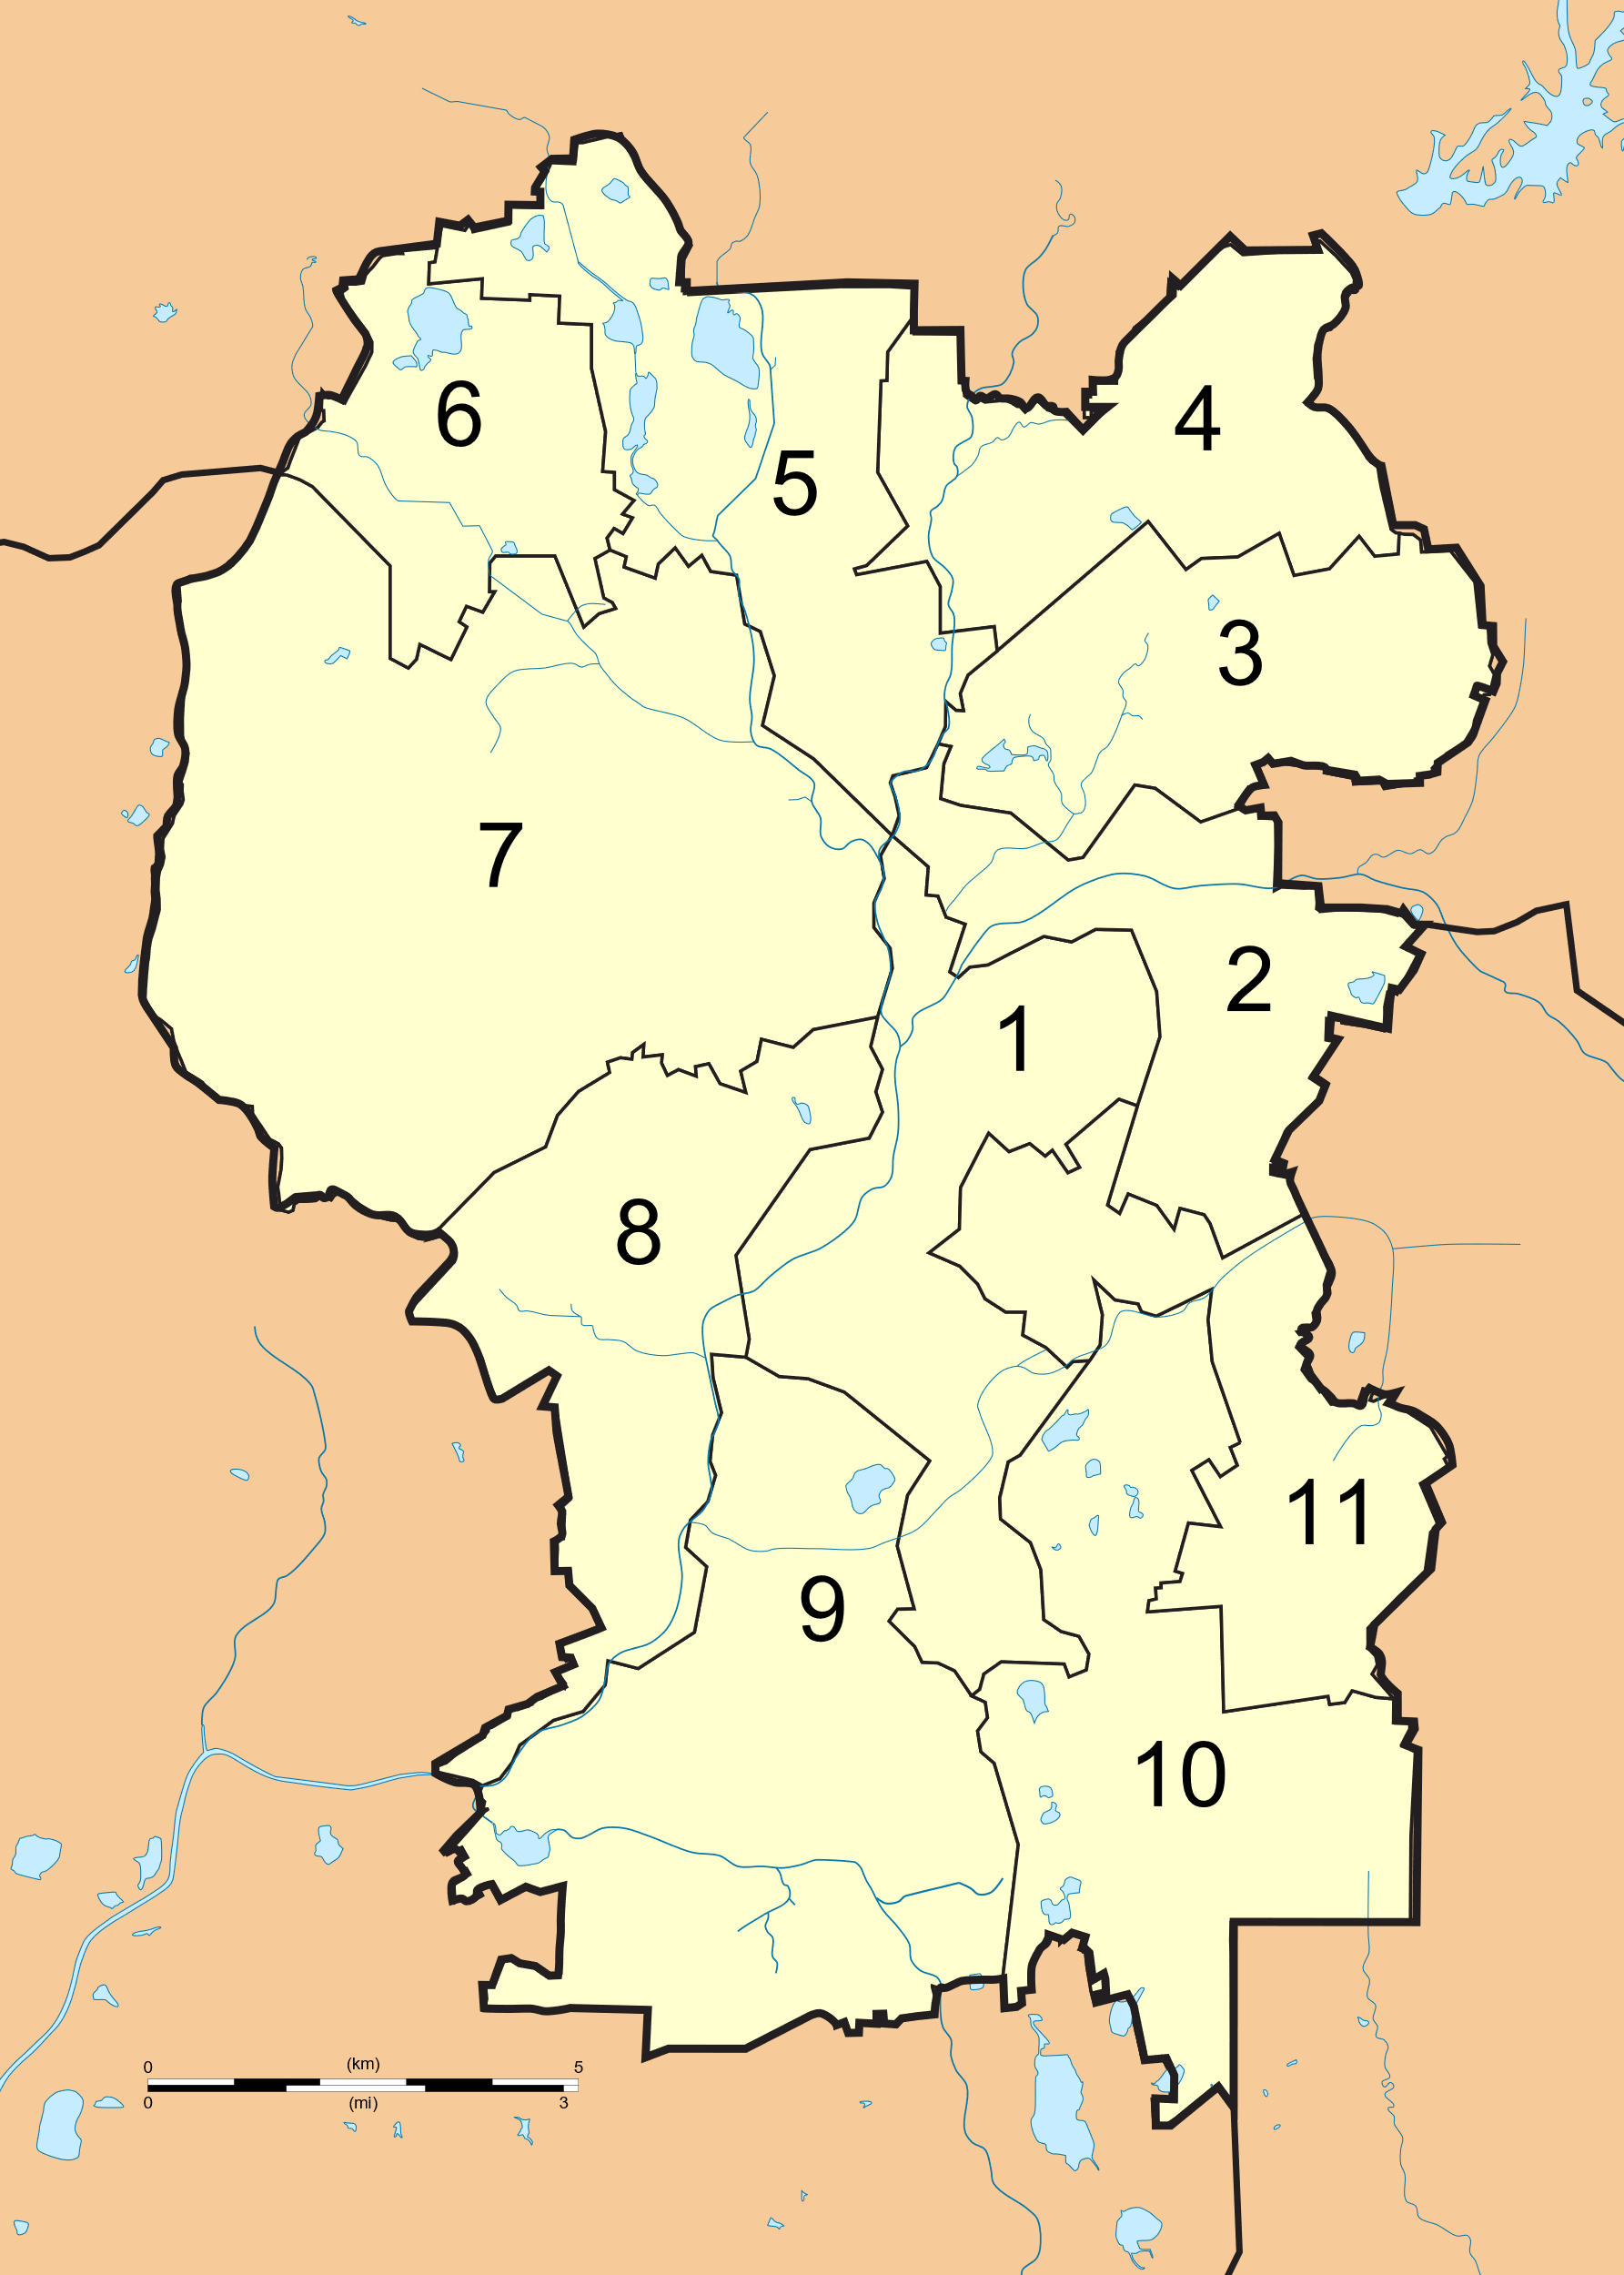
Background
The dazzling city of Kuala Lumpur is the federal territory of Malaysia, which the situated in the heart of South East Asia. The city is populated by more than 1.73 million people in the recent years.
Kuala Lumpur is the cultural, financial and economic centre of Malaysia. It is also home to the Parliament of Malaysia and the official residence of the Yang di-Pertuan Agong (the King), the Istana Negara (Royal Palace). The city is the role model of modern urban lifestyle in the country equivalent to its neighbor, Singapore.
The city consists of 11 parliamentary constituents which forming a division within the city. Each constituent represents a seat in the Parliament of Malaysia who will be filled by leader of political party who won during the General Election for each area.
Coffee is among the favorite drinks by this City dwellers. Coffee consumption habit within the city is very dynamic as it represents City trend and lifestyle. Thus, this makes café businesses bloom within the City and stiff competition among them.

Slide 3
Description of the Business Problems
There are numbers of problems that will be addressed in the Project as a baseline:
1. What is the key area within Kuala Lumpur?
Due to unique management of Kuala Lumpur, the segregation of area in the City was made in general. For example, the area of Kuala Lumpur was segregated into 11 parliamentary constituents. Which was too general for a 243 km² area.
Malaysia also uses postcode system. However, in Kuala Lumpur there are around more than 200 postcode which are too specific. The area postcode does not really help as the postcode areas are not equally distributed. This means some area may have a concentrated number of different postcodes than the other.
Thus, this Project will address alternative method to determine Kuala Lumpur key area. We will utilize data on government clinics around Kuala Lumpur to address this question.

Slide 4
Description of the Business Problems (cont’d)
2. Where is the best place to open a Café in Kuala Lumpur?
With intense competition between Café establishment in Kuala Lumpur, this Project will shed some lights to new business owner in strategizing their business plan.
Most of the new business will have a problem when they need to compete head-on with bigger, more matured direct competitors as they might have established their own branding prowess and huge customer-based client. One of the strategy is to be as far as possible (location wise) with direct competition and grow organically from there. If this is not possible, focusing on a more ‘diluted’ location is also an alternative strategy.
This Project is envisaged to give ideas to new Café owners to reduce the head-on competition with existing business by strategically locating their business.

Slide 5
Description of the Business Problems (cont’d)
3. What is the best description of Kuala Lumpur?
As we are looking for places to open our Café, why not we go further and analyze the City as overall?
There must be a lot of activities that can be done in Kuala Lumpur. Based on Foursquare data, we will further analyze the top attractions/ activities that can be done on this vibrant City.

Slide 6
Main Audience of This Project
Main audience for this Project is as follows:
Prospective Café owners- This project is envisaged to give insights to prospective Café owners on how to strategize their Café opening in Kuala Lumpur.
Coffee Lovers- Coffee Lovers can focus their search for the best Coffee on the area highly populated with Café establishment.
Tourists- With more analysis on the description of Kuala Lumpur, tourists can get some insights on what to be expected from their visit to Kuala Lumpur next time.
Data Scientists- Since there is a gap in the determination of key areas in Kuala Lumpur for the same kind of study, this Project will be the baseline resource or the starting point on the analysis of Kuala Lumpur in the future.

Slide 7
Dataset Utilization
There are 3 primary baseline datasets proposed to be utilized in this Project:
No | Dataset | Remarks
1 | List and location of government clinics from Ministry of Health. https://www.moh.gov.my/index.php/database_stores/store_view/1?search=Kuala+lumpur&items=25&page=1 | The location of the clinics will be the best baseline of identifying key areas in Kuala Lumpur. Government objective to provide medical access to every citizen means that the location should be at the strategic point within the city
2 | Location data from Foursquare API | This will be used to analyze the surrounding activities of the city
3 | Location data from HERE Location Services API | This will be use for geocoding and reverse geocoding

Slide 8
Thank You

